Slide 1

Netflix TV shows & Movies

Slide 2
Research Questions
1-What is the movie to show ratio
2- what is the most productive country
3-what is the most produced genre
4-what is the most produced age certification
5-does the movie making buisness increase every year
6-what is the average imdb score for every age certification

Slide 3
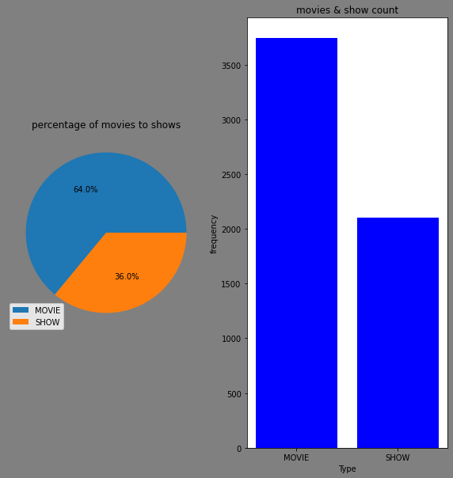
As we see from the chart that the Movies are considered 64% of all products

Slide 4
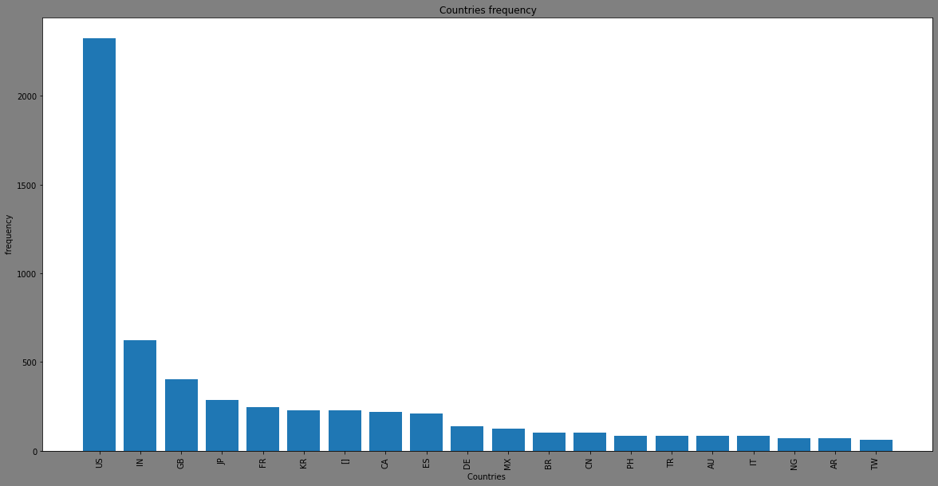
We can see that USA is the most producrive country with more than 2000 product , next is india with about 600 product

Slide 5
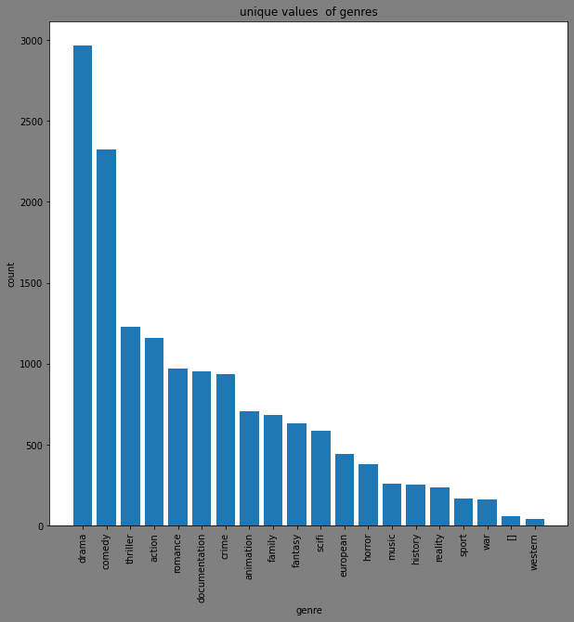
Drama is the most produced genre with about 3000 product

Slide 6
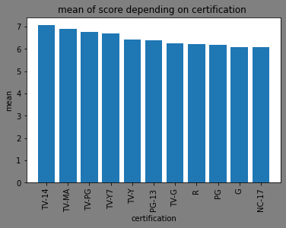
TV-14 has the best average score

Slide 7
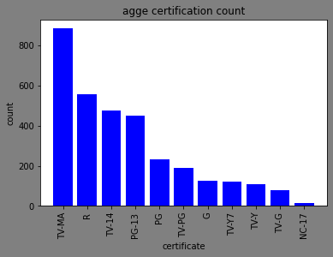
TV-MA is the most produced genre

Slide 8
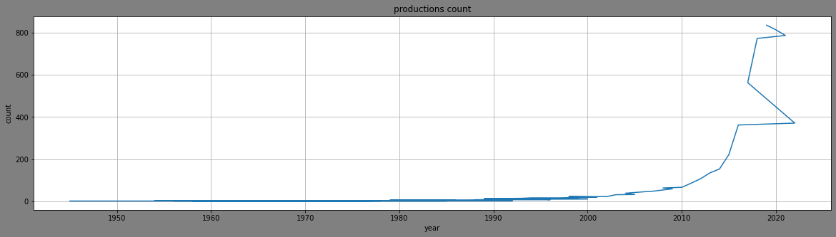
As we can see here .the movie making business has skyrocketed dynamically since 2010 from about 100 product in 2010 to more than 800 in 2020

